Slide 1
Languages for Learning: A Pedagogy for EAL
Newcastle, UK
10th-11th November 2016
Lecture 1, day 2
Dr Leena Robertson, Prof Nathalie Auger, Christel Houée, Dr Heather Smith, Patrick Wilkins, Zaneta Karchnakova, Marta Kaliasova
http://research.ncl.ac.uk/romtels/resources/

Slide 2
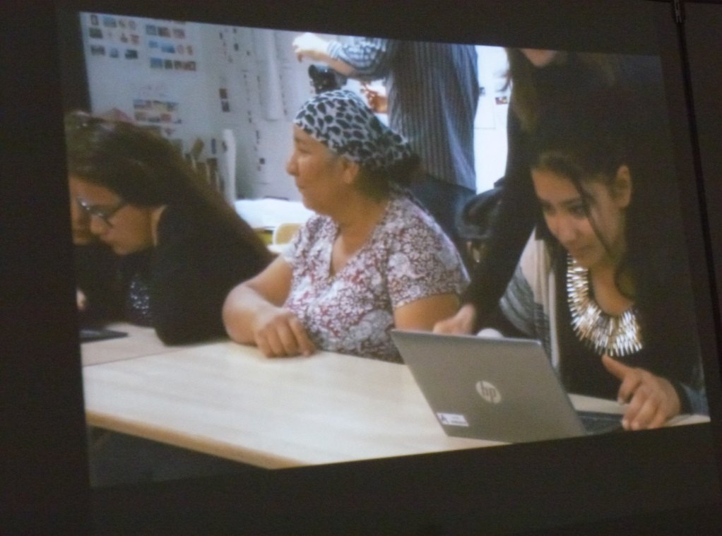
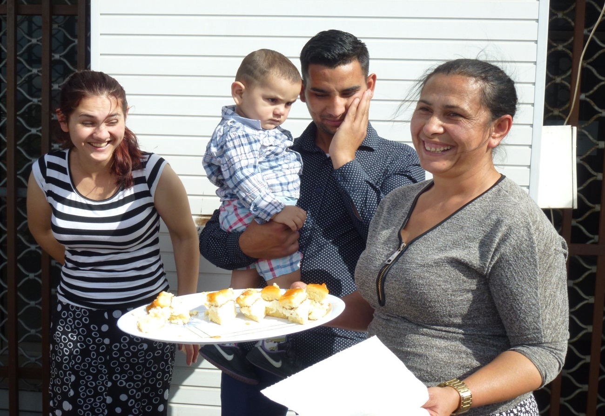
Working with families as language experts

Slide 3
How to create teaching-and-learning environments that are characterised by mutual understanding?
School
populations: children’s
linguistic, racial, cultural backgrounds and socioeconomic situations
Professional bodies:
teachers’ linguistic,
racial, cultural backgrounds and socioeconomic situations

Slide 4
How to create teaching-and-learning environments that are characterised by mutual understanding?
School
populations: children’s
linguistic, racial, cultural backgrounds and socioeconomic situations
Professional body:
teachers’ linguistic, racial, cultural backgrounds and socioeconomic situations
Meritocratic policy context privileging conformity and standardisation
and not diversities and inclusiveness

Slide 5
School
populations: children’s
linguistic, racial, cultural backgrounds and socioeconomic situations
Professional body:
teachers’ linguistic, racial, cultural backgrounds and socioeconomic situations
Meritocratic policy context privileging conformity & standardisation and not inclusiveness
In addition how to develop practices that counteract negative impact of pervasive deficit views?

Slide 6
‘funds of knowledge’
‘historically accumulated and culturally developed bodies of knowledge and skills essential for household or individual functioning and well-being’
(González, Moll, & Amanti, 2005:72)
‘to better describe forms of knowledge that arise dynamically from a range of everyday experiences among marginalized - and therefore poorly understood - populations who interact with ‘mainstream’ society via its social structures’
(Rodriguez, 2013:90)

Slide 8
‘culture’ as a construct
‘Culture’ in education – now an acceptable tool to drive a wedge between groups of people?
Essentialist and tokenistic?
‘We in the West’ have developed cultures, from which we pick and mix, but in other parts, people are ‘prisoners of their backward culture’?

Slide 9
‘culture’ as a construct in education
‘Culture’ – now an acceptable tool to drive a wedge between groups of people?
Essentialist and tokenistic?
‘We in the West’ have developed culture, but in other parts, people are ‘prisoners or their backward culture’?
‘funds of knowledge’
transformative potential of teaching:
learning is a socially mediated set of processes that reflect the influence of social history and context
intentionality – to encourage teachers to use resources outside the classroom, their pupils’ funds of knowledge

Slide 10
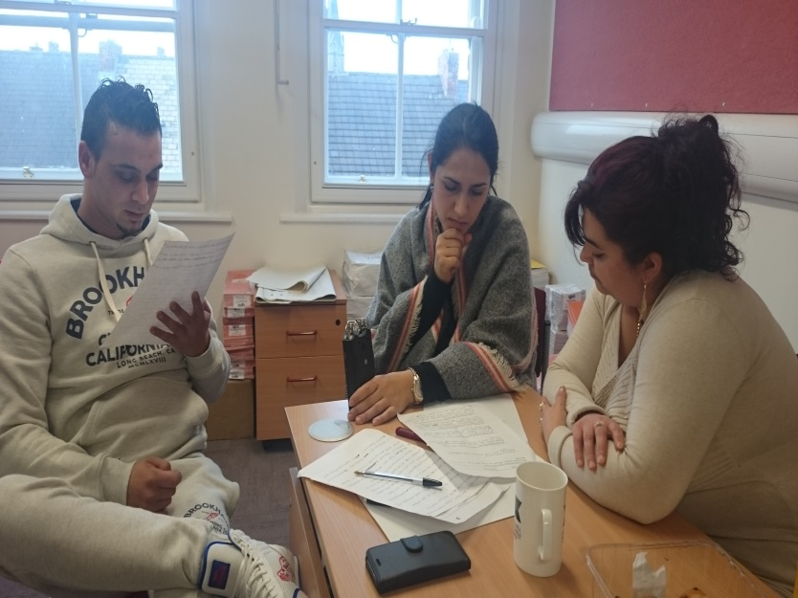
Funds of knowledge:
languages
Roma is often kept for communication in the home.
Roma do not necessarily name their languages/dialects.
 | Slovak Republic | Czech Republic | Romania
Newcastle | 1. East Slovak Romani | Not identified BUT can understand East Slovak Romani | Ursari
 | 2. Czech Vlax
Montpellier |  |  | Ursari
Romania |  |  | Korturare
Helsinki | unknown

Slide 11
developing translanguaging as a tool for learning in schools families as collaborators, co-researchers and co-constructors
becomes possible with
press now

Slide 12
‘Nothing about us without us’ (Roma rights 2015)
Working together with parents as language experts

Slide 13
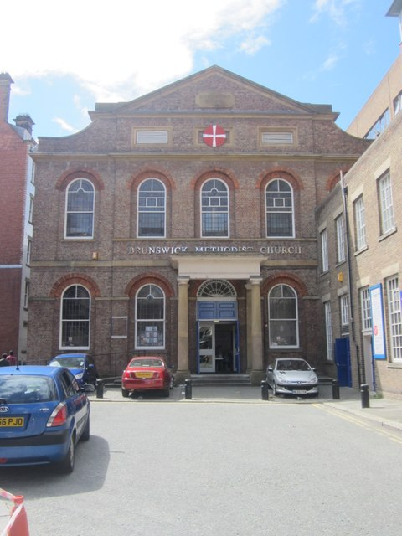
Brunswick Methodist church
One cold December Monday morning in 2014 …..

Slide 14
“It was absolutely fascinating. One group of Roma women, some quite elderly, were delighted to talk with me about their own heritage and language and in the end they also told me about some of the other Roma groups in attendance. This was because one group in particular refused to acknowledge their Roma heritage and one man (who I recognised as a Big Issue seller on one Newcastle street) said he was quite insulted that we would suggest such a thing. I can say with certainly however, that at this event there was no contact between this group and other families. So with a little help from one grandmother, a group of lively women and a group of young Romanian Roma men who were also more than happy to talk about their heritage, this is what I found out”
Ursari (musicians)
Platosi (copper/tin makers of pots and roofs)
lingurāreasca (traditionally makers of pots and spoons)
Cāldarari (makers of big pots)
Romonizoti

Slide 15
I was told repeatedly by several groups that the children were better at Romanian than the Roma languages. So, now we began to understand the linguistic complexities….
Meetings at the school with Slovak parents from the Roma community and Zaneta, the school’s community worker and translator! We explained the research project through a pictorial powerpoint. We stressed the project was a way to help them help their children. We made no assumptions about them being so-called ‘hard to reach’ parents. Our goal was to do the reaching…
fluent Roma, not much Slovak
mostly Slovak, a few words of Roma (Slovak and Roma mixed together)
mostly Slovak, a few words of Roma learned from other children (not from parents)
Slovak; understand some Roma but not spoken at home
mixture of Slovak and Roma
mostly Roma
mixture of Czech, Slovak and Roma.

Slide 16
We started to understand:
Children were likely to know a mixture of Slovak and Romani
We needed to identify which Romani dialect exactly they spoke
This would be a difficult task as parents did not ‘name’ their language beyond ‘Roma’. We turned to http://romani.humanities.manchester.ac.uk
The parents were fascinated by this process. Some commented that they were amazed anyone was taking an interest in their languages.
The only possible experts in how this translanguaging worked in practice was their parents!

Slide 17
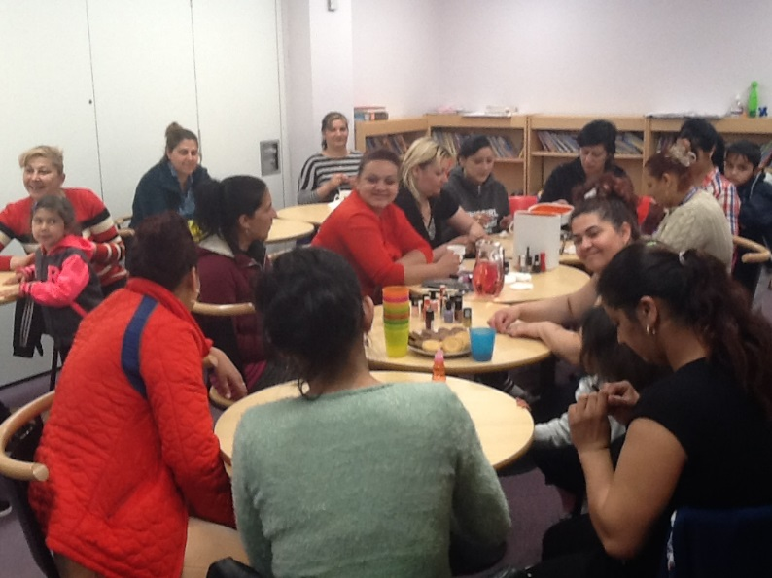
“We joined the mums in the food technology room, where a local caterer was leading an international cooking demonstration, making falafel. With Zaneta’s translation Heather spoke with the mums and introduced the idea that some parents would be paid to do translation work for short animated videos as part of the project. This will need to take place after half term, either at the school or at the University.”
Meanwhile Arthur’s Hill Federation schools had set up regular special activities

Slide 18
We then began the process of ‘translanguation’ (translanguaged translation).
This took many hours and days to complete.
Now Marta and Zaneta are helping us translate the children’s conversations back into English!

Slide 19
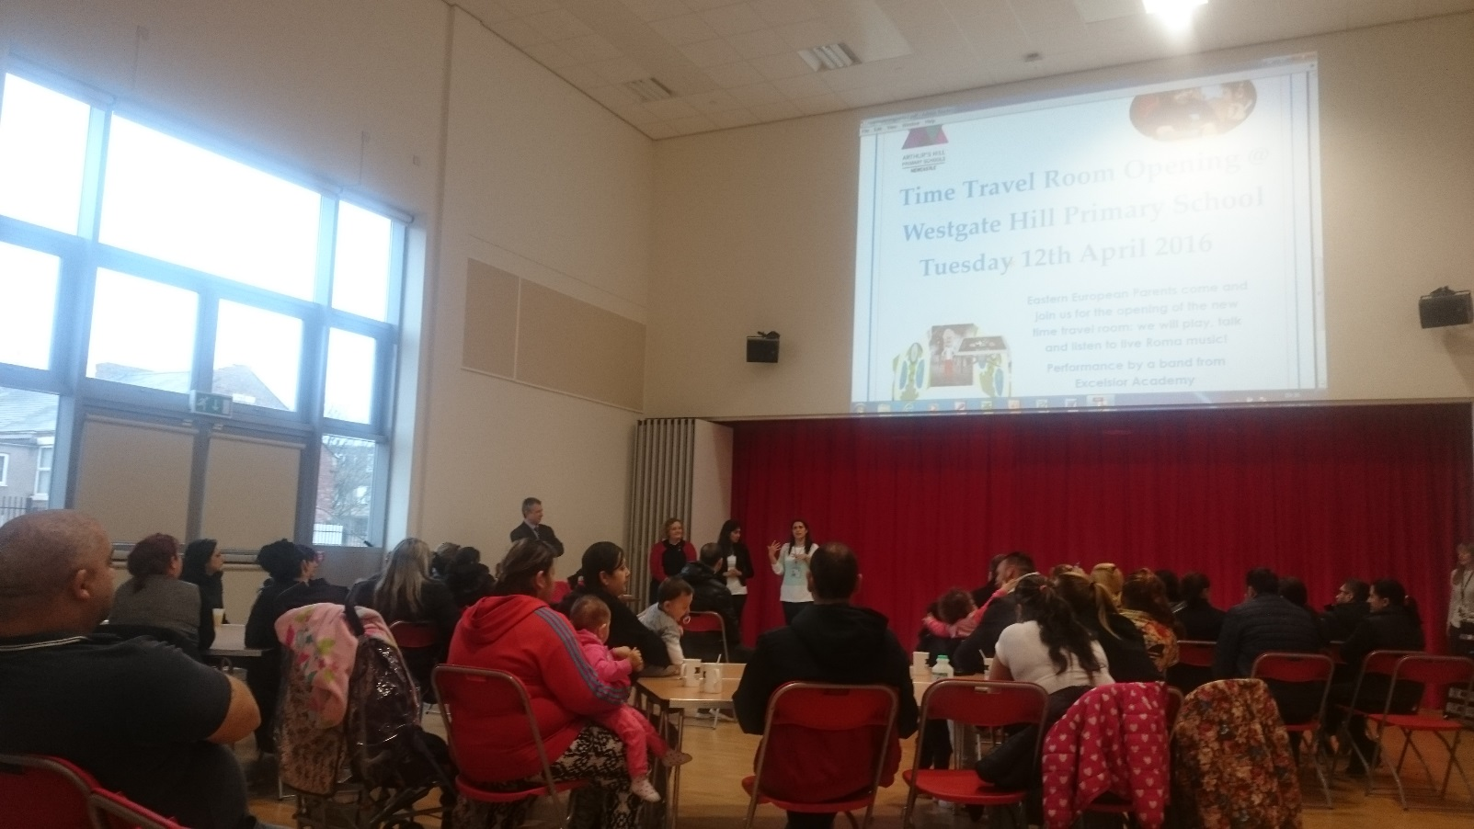
Roma Celebration/Opening the room event

Slide 20
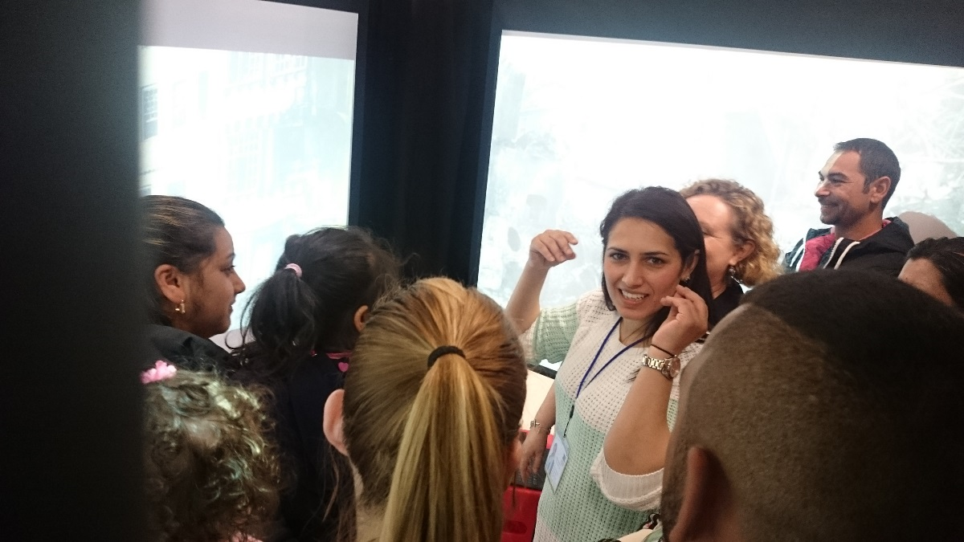
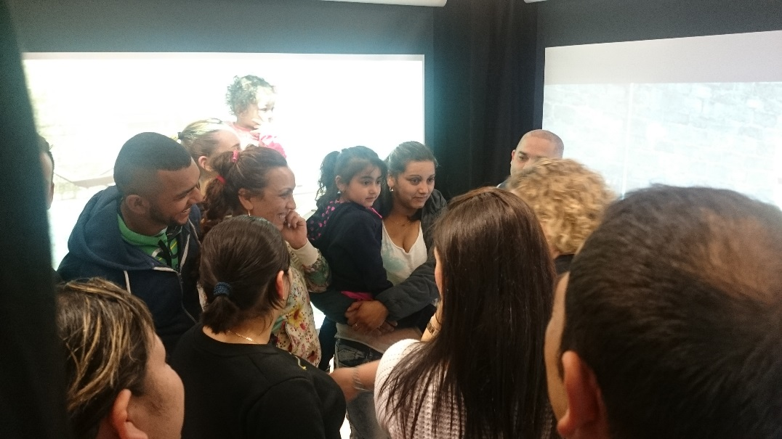

Slide 21
We are now repeating the process with the Romanian Roma families, most of whom appear to speak a translanguaged form of Romanian and Ursari.
So, what did we learn that might be useful to you:
Simple language surveys aren’t always accurate (or sensitive)
Find a gatekeeper (ideally a member of the Roma community or someone who has worked with the communities for many years) who the community trusts; build meaningful and reciprocal relations with the community through the gatekeeper. NOTE THIS TAKES TIME and hence commitment
Be wary of people who present themselves as ‘talking for a community’ – find someone on the ground actually doing this work
Once you meet the families, try a list of words (or a bank of pictures) for translation. For Roma communities use the Manchester database and work backwards: you will meet one of the founders in a short while

Slide 22
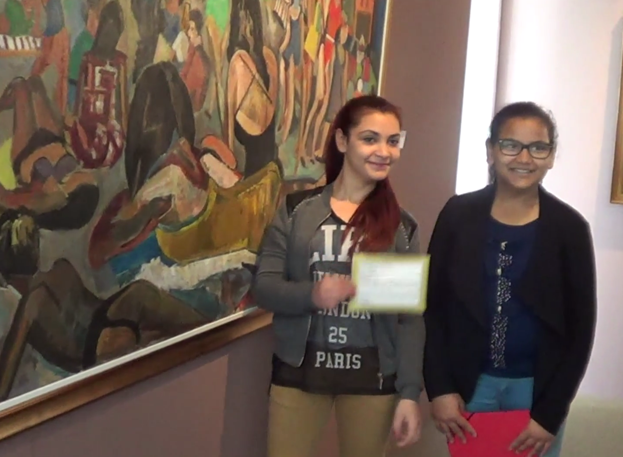
And now from our partners in France…
A trip to the museum anyone?

